Slide 1
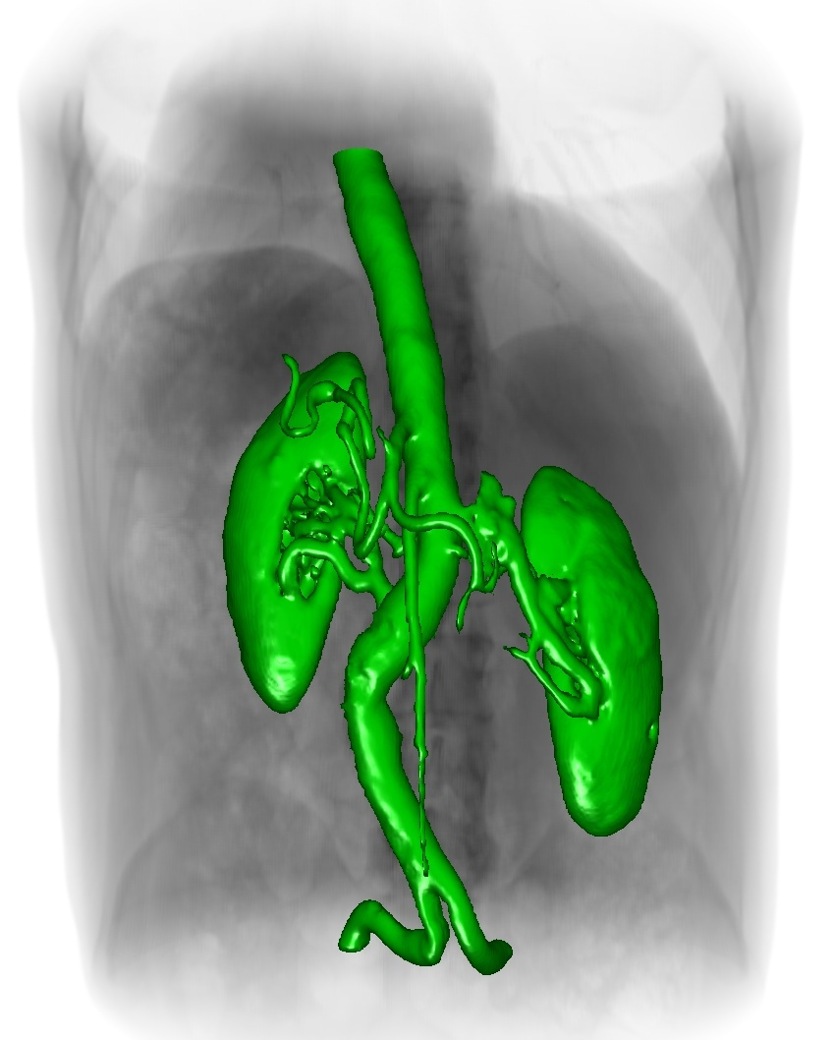


A Work-Efficient GPU Algorithm for Level Set Segmentation
Mike Roberts
Jeff Packer
Mario Costa Sousa
Joseph Ross Mitchell

Slide 2
What do I mean by work-efficient?
If a parallel algorithm performs asymptotically equal work to the most efficient sequential algorithm, then the parallel algorithm is work-efficient.
Notes:
updating active set based only on non-zero gradient condition – lots of active voxels

Slide 3

What do I mean by segmentation?
Notes:
updating active set based only on non-zero gradient condition – lots of active voxels

Slide 4

What do I mean by segmentation?
Notes:
updating active set based only on non-zero gradient condition – lots of active voxels

Slide 5
What do I mean by segmentation?
Goal: Fast, interactive, and accurate segmentations even when the data is noisy and heterogeneous
Notes:
updating active set based only on non-zero gradient condition – lots of active voxels

Slide 6
Why Level Sets?
Good: Competitive accuracy compared to manual segmentations by experts (Cates et al. 2004)

Slide 7
Why Level Sets?
Good: Competitive accuracy compared to manual segmentations by experts (Cates et al. 2004)
Bad: Can be slow, even on the GPU

Slide 8
Why Level Sets?
Good: Competitive accuracy compared to manual segmentations by experts (Cates et al. 2004)
Bad: Can be slow, even on the GPU
This limitation motivates our algorithm

Slide 9
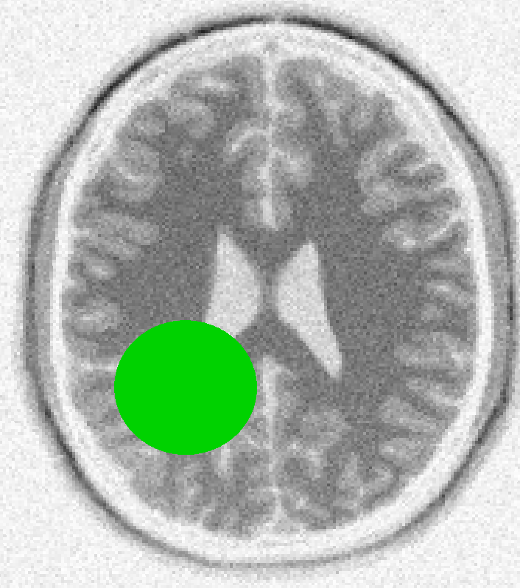

Segmentation with Level Sets
Embed a seed surface in an image
Iteratively deform the surface along normal according to local properties of the surface and the underlying image
iterations

Slide 10
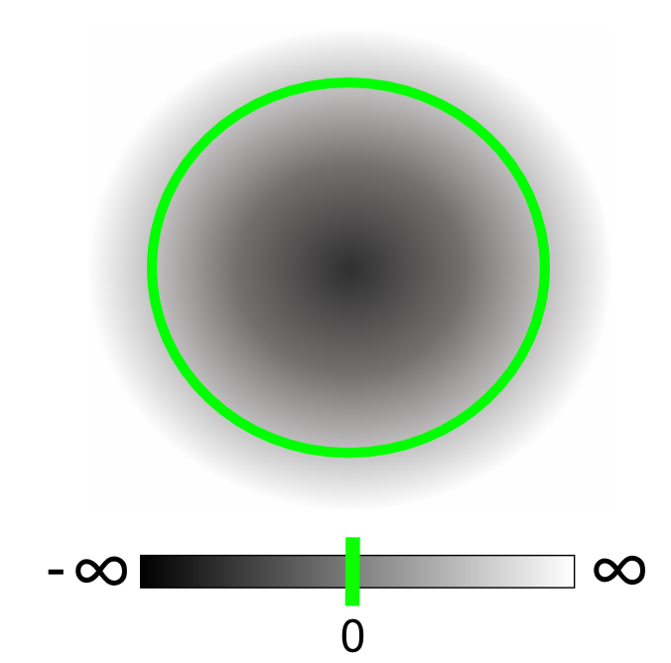
Segmentation with Level Sets
Represent the level set surface as the zero isosurface of an implicit field
Notes:
initialized and maintained such that the field value represents the distance to the zero isosurface
for our purposes, it is OK if we only maintain a very approximate distance transform

Slide 11
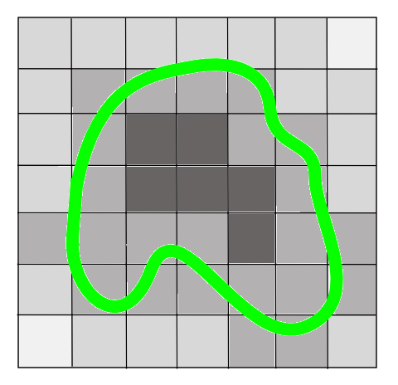
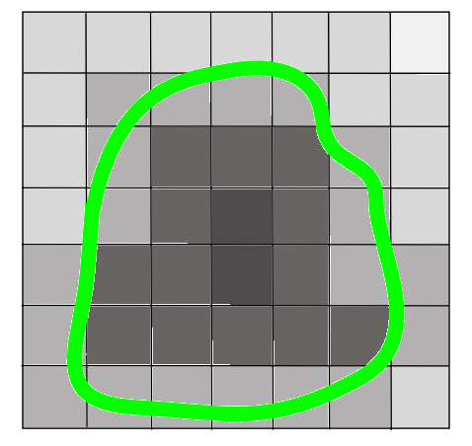
Segmentation with Level Sets
Deformation occurs by updating fixed elements in the implicit field
Surface splitting and merging events are handled implicitly
Requires many small iterations for surface to converge on a region of interest
Notes:
computational fluid dynamics analogy – Eulearian simulation instead of Lagrangian

Slide 12

Speed Function
Speed function proposed by Lefohn et al. 2003, 2004
grow
curvature
image intensity
contract
data term
curvature term
controls the smoothness of the segmentation
Notes:
speed function is an affine combination of two terms: a data term and a curvature term
the data term is simply a hat function that encourages surface growth when the image intensity is within a given range
the curvature term acts like surface tension to encourage a smooth segmentation
the relative influence of each term is controlled by the user-specified parameter alpha.
this means that alpha effectively controls the smoothness of the segmentation

Slide 13
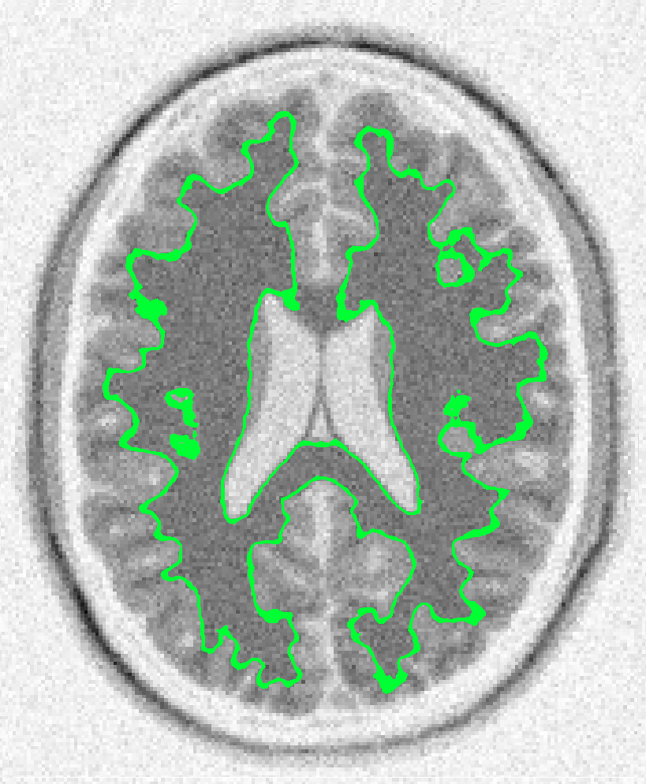

Speed Function
The curvature term enforces a smooth segmentation and prevents leaking
with curvature influence
without curvature influence

Slide 14
Previous Work
CPU
Narrow Band (Adalsteinson and Sethian 1995)
Sparse Field (Whitaker 1998, Peng et al. 1999)
Sparse Block Grid (Bridson 2003)
Dynamic Tubular Grid (Nielson and Museth 2006)
Heirarchical Run-Length-Encoded (Houston et al. 2006)
Above algorithms:
leverage spatial coherence by only processing elements near level set surface
require at least linear time to update the level set field
GPU
GPU Narrow Band (Lefohn et al. 2003, 2004; Jeong et al. 2009)
Requires a linear number of steps to update the level set field
Saves memory by only storing a sparse representation of the level set field

Slide 15
Our Approach
Leverage spatial and temporal coherence in the level set simulation to reduce GPU work

Slide 16
Our Approach
Leverage spatial and temporal coherence in the level set simulation to reduce GPU work
Contributions:
Novel algorithm that limits computation by examining the temporal and spatial derivatives of the level set field
Work-efficient mapping to many-core GPU hardware that updates the level set field in a logarithmic number of steps

Slide 17
Leveraging Temporal Coherence
We only want to spend time updating the voxels that are actually changing
Notes:
Previous work computes only around narrow band.
We make the observation that even areas around narrow band can be avoided if they have locally converged

Slide 18
Leveraging Temporal Coherence
Necessary conditions for voxels to be in the active computational domain:
Are we close to the surface border? (Lefohn et al. 2003)
Is the field neighborhood changing over time?
Notes:
If either condition is true, the level set update equations guarentee that the new field value will be equal to the old field value, so we don’t need to update.

Slide 19
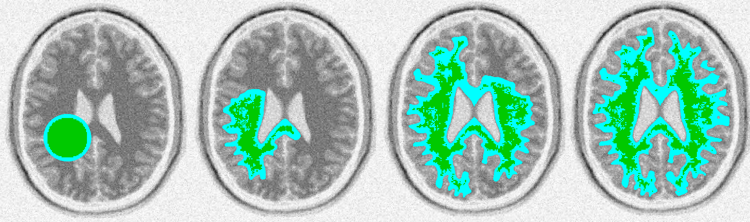
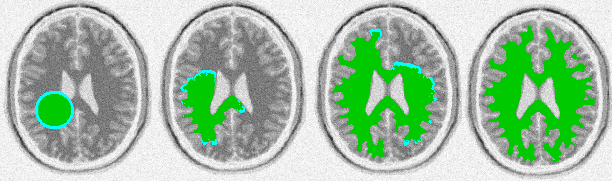
Leveraging Temporal Coherence
“Are we close to the surface border?”
“Are we close to the surface border?” AND “Is the field neighborhood changing over time?”
currently active computational domain
segmented region
Notes:
updating active set based only on non-zero gradient condition – lots of active voxels

Slide 20
Live Demo

Slide 21
Temporally Coherent Algorithm
Initialize level set field and active computational domain
Update level set field at active voxels
Voxels changing in space and time form the new active computational domain
No
Is active computational domain empty?
Yes
Segmentation converged

Slide 22
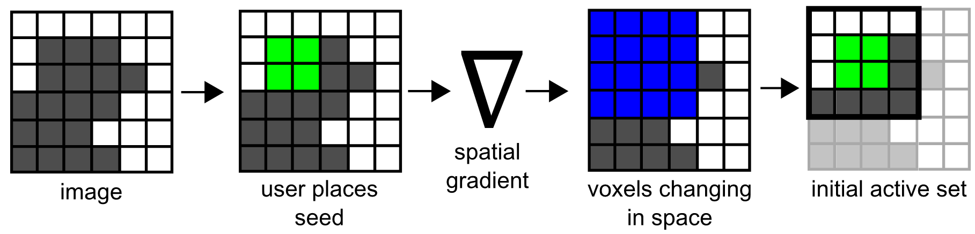
Initializing the level set field and the active computational domain

Slide 23
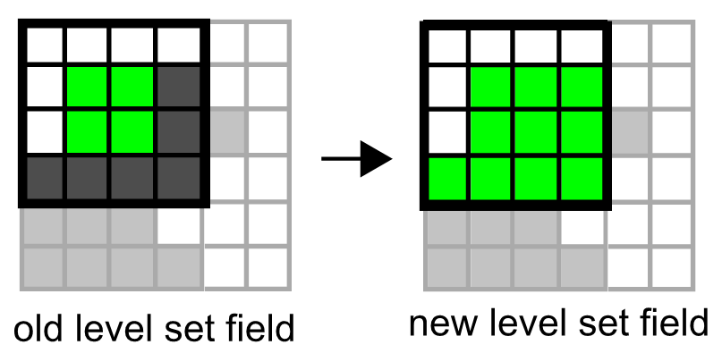
Updating the level set field at active voxels

Slide 24
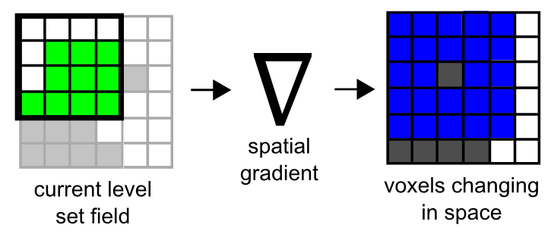
Finding the voxels that are changing in space

Slide 25
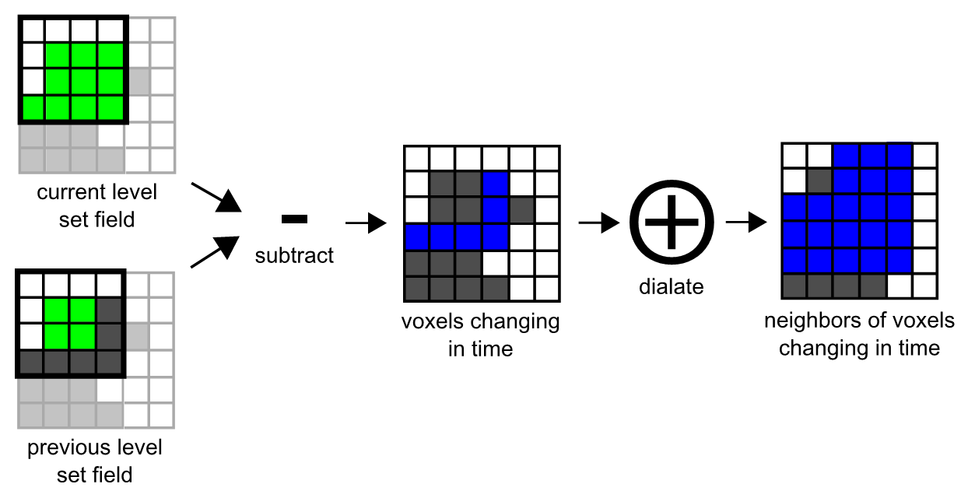
Finding the voxels that are changing in time

Slide 26
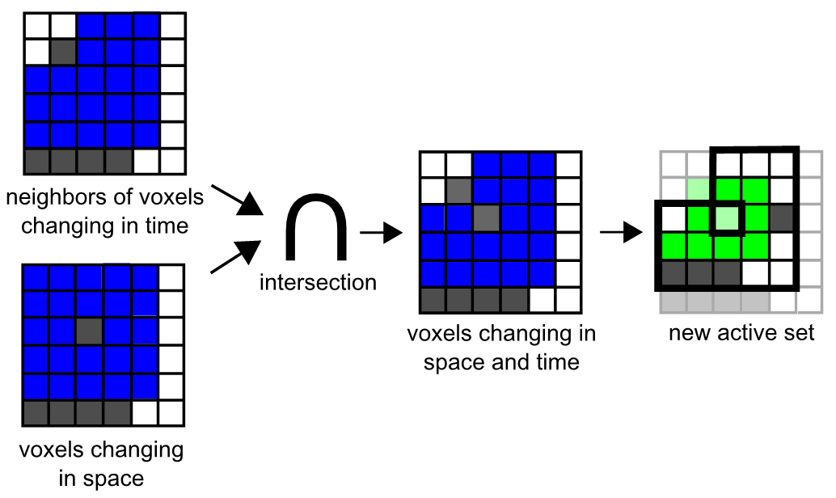
Finding the voxels that are changing in space and time

Slide 27
Our Work-Efficient GPU Pipeline
Initialize dense list of active coordinates
Update level set field at active coordinates
Generate new active coordinates (duplicates are OK)
No
Remove duplicates
Compact new active coordinates into a new dense list
Is the new dense list empty?
Yes
Segmentation Converged

Slide 28
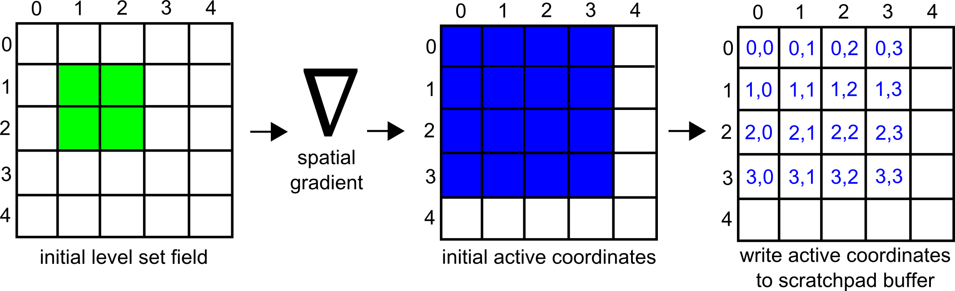
Initializing a scratchpad buffer with active coordinates

Slide 29
Compacting the scratchpad buffer to produce a dense list
Compact
For more details see Harris et al. 2007; Sengupta et al. 2007, 2008

Slide 30

Updating the level set field at active coordinates

Slide 31
Generating new active coordinates into a series of auxiliary buffers (duplicates are OK)

Slide 32
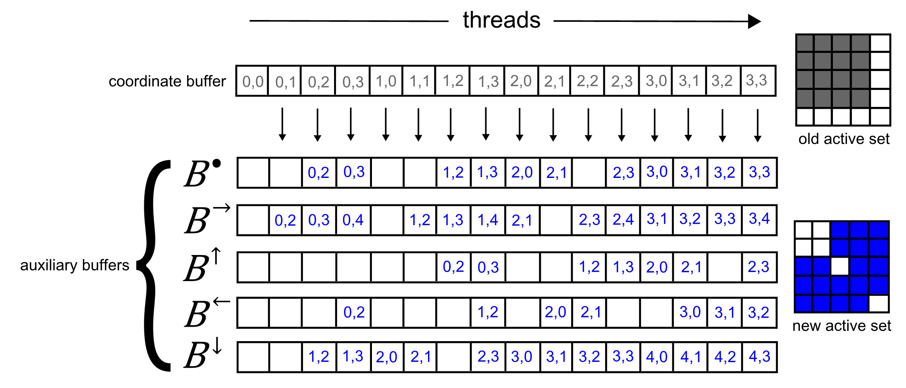
Generating new active coordinates into a series of auxiliary buffers (duplicates are OK)

Slide 33
Generating new active coordinates into a series of auxiliary buffers (duplicates are OK)

Slide 34
Generating new active coordinates into a series of auxiliary buffers (duplicates are OK)

Slide 35
Generating new active coordinates into a series of auxiliary buffers (duplicates are OK)

Slide 36
Generating new active coordinates into a series of auxiliary buffers (duplicates are OK)

Slide 37
Generating new active coordinates into a series of auxiliary buffers (duplicates are OK)

Slide 38
Generating new active coordinates into a series of auxiliary buffers (duplicates are OK)

Slide 39
Generating new active coordinates into a series of auxiliary buffers (duplicates are OK)

Slide 40
Generating new active coordinates into a series of auxiliary buffers (duplicates are OK)

Slide 41
Generating new active coordinates into a series of auxiliary buffers (duplicates are OK)

Slide 42
Generating new active coordinates into a series of auxiliary buffers (duplicates are OK)

Slide 43
Generating new active coordinates into a series of auxiliary buffers (duplicates are OK)

Slide 44
Generating new active coordinates into a series of auxiliary buffers (duplicates are OK)

Slide 45
Generating new active coordinates into a series of auxiliary buffers (duplicates are OK)

Slide 46
Removing duplicate active coordinates from the auxiliary buffers

Slide 47
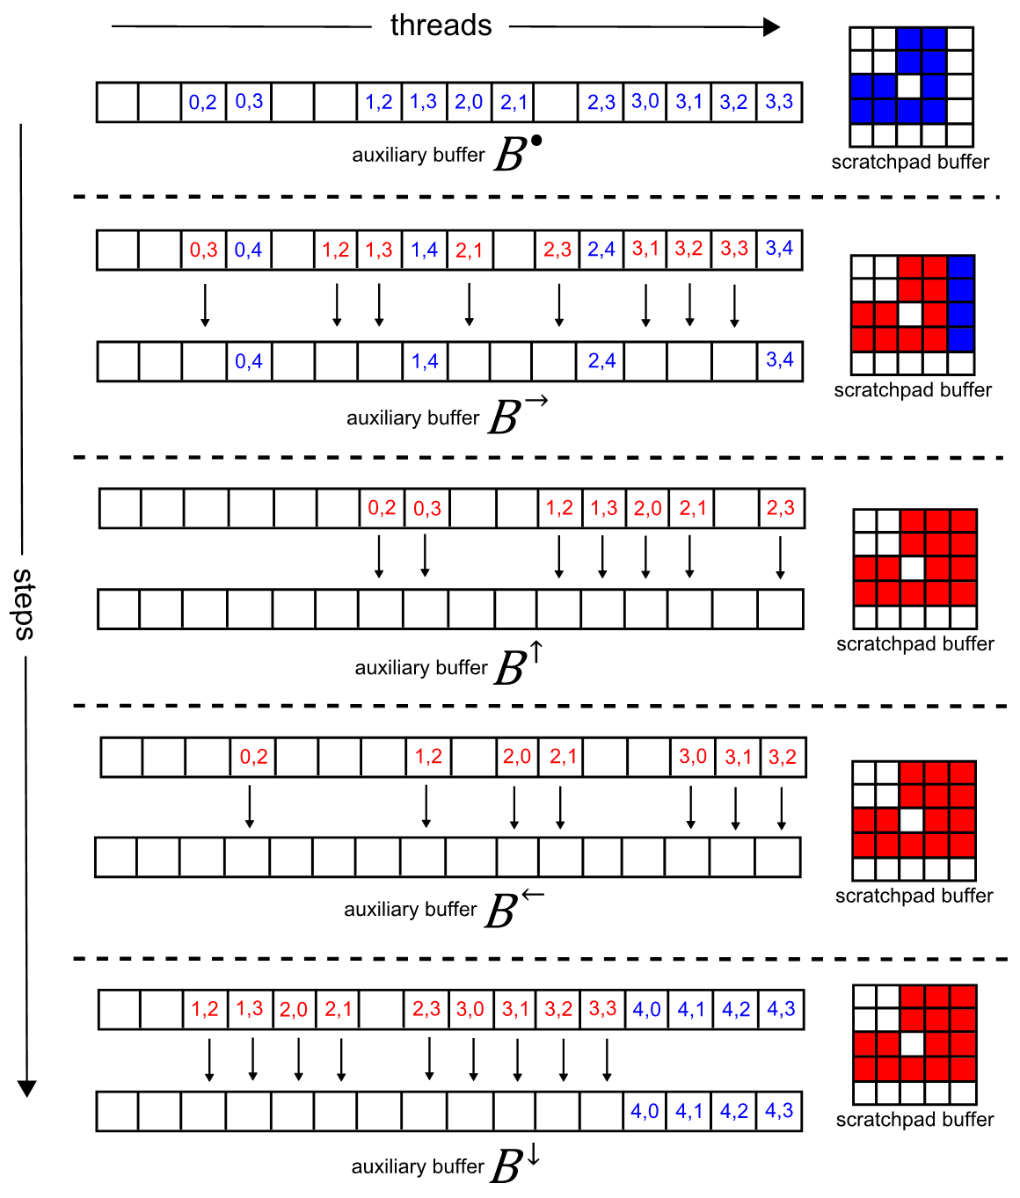
Removing duplicate active coordinates from the auxiliary buffers

Slide 48
Removing duplicate active coordinates from the auxiliary buffers

Slide 49
Removing duplicate active coordinates from the auxiliary buffers

Slide 50
Removing duplicate active coordinates from the auxiliary buffers

Slide 51
Removing duplicate active coordinates from the auxiliary buffers

Slide 52
Removing duplicate active coordinates from the auxiliary buffers

Slide 53
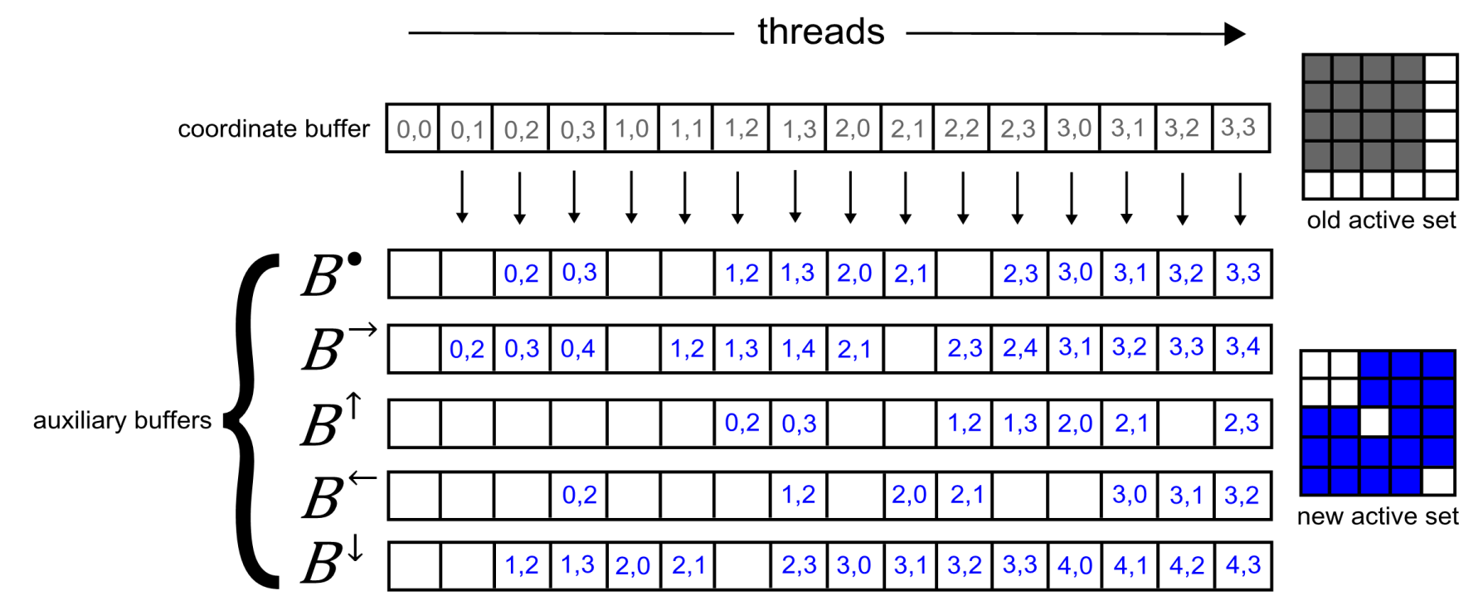
Compacting the auxiliary buffers to produce a new dense list of active coordinates
Compact

Slide 54
Asymptotic Complexity
Compact (Harris et al. 2007; Sengupta et al. 2007, 2008)
O(logn) steps
O(n) work
Rest of our algorithm
O(1) steps
O(n) work
Good: Our algorithm is work-efficient and requires a logarithmic number of steps to update the level set field
Bad: Our algorithm requires memory proportional to the size of the level set field

Slide 55
Experimental Methodology
256x256x256 human head MRI (ground truth from expert)
Segmented white and grey matter
Variety of noise levels
10 repeated segmentations per noise level
Nvidia GTX 280
Measured computational domain size, speed, accuracy
Repeated using our algorithm and the GPU narrow band algorithm (Lefohn et al. 2004)

Slide 56
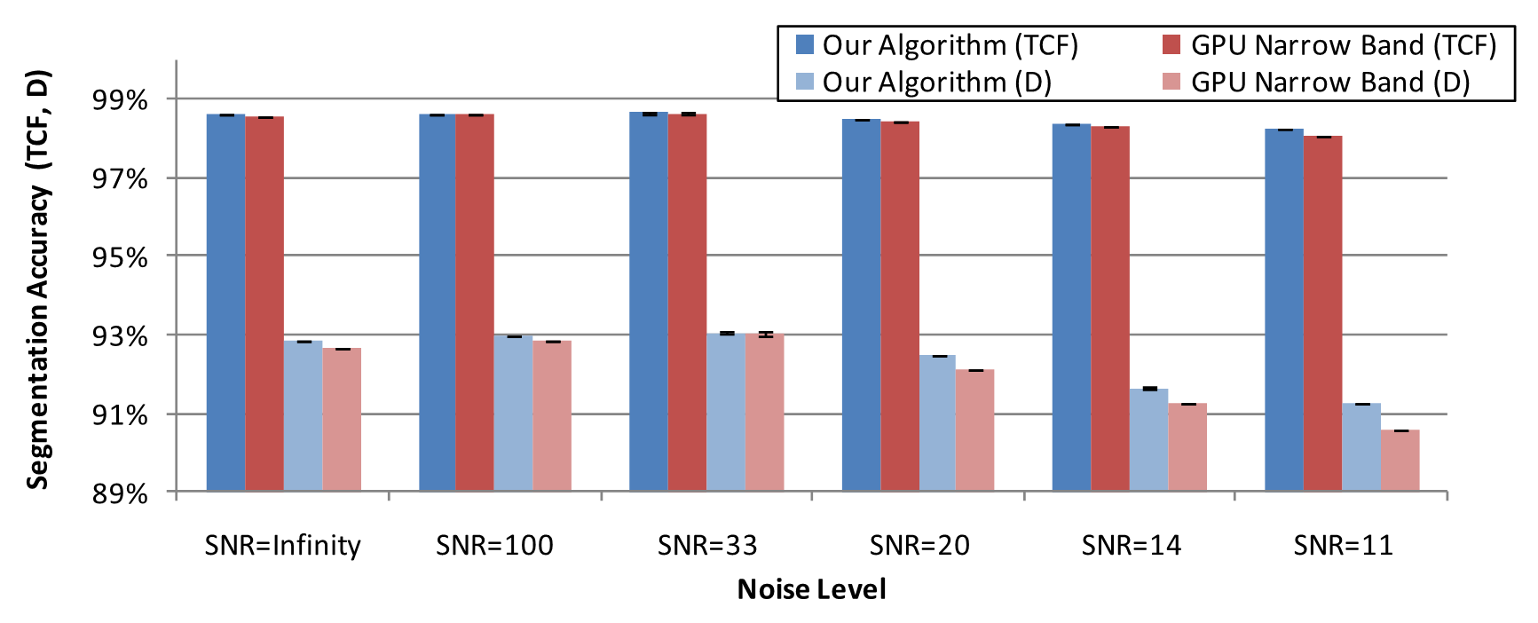
Accuracy
SNR = Signal-to-noise Ratio
D = Dice Coefficient
TCF = Total Correct Fraction of Labeled Voxels

Slide 57
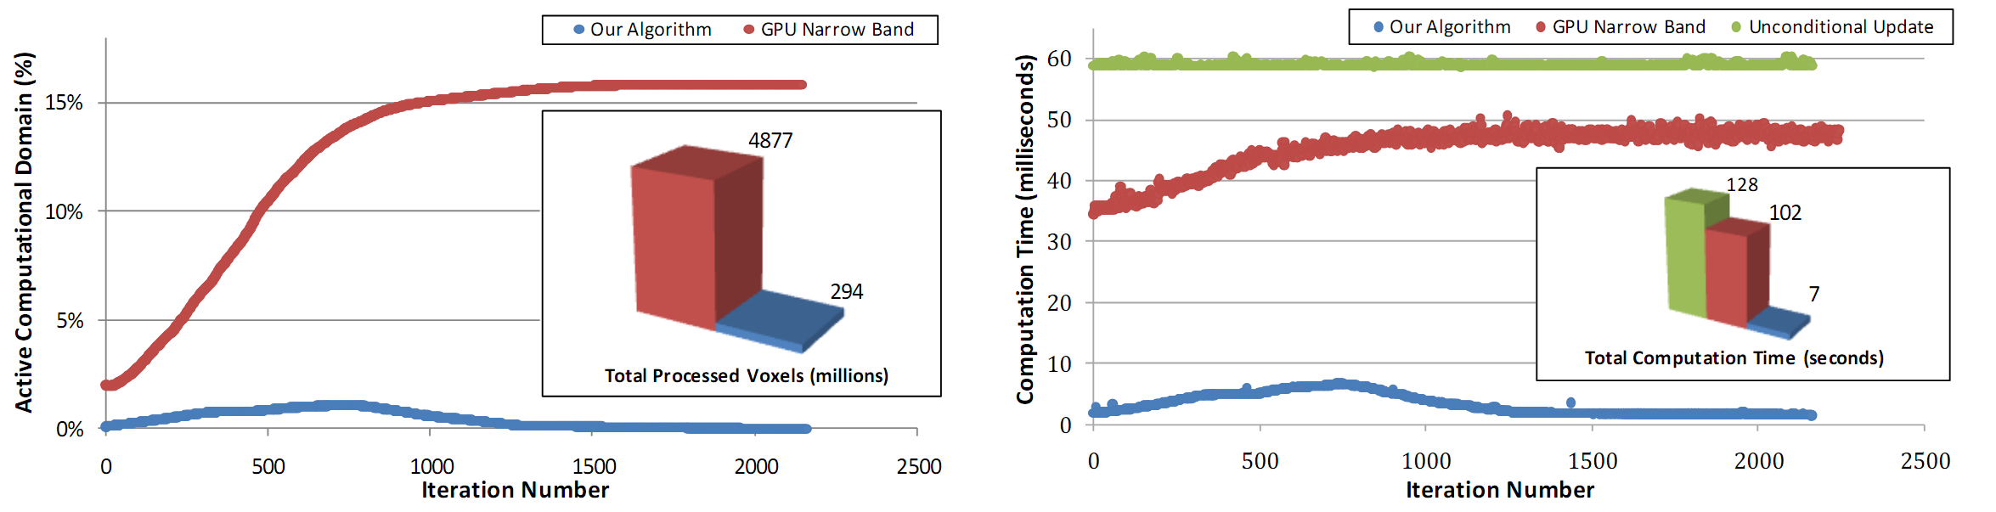
Computational Domain Size

Slide 58
Speed

Slide 59
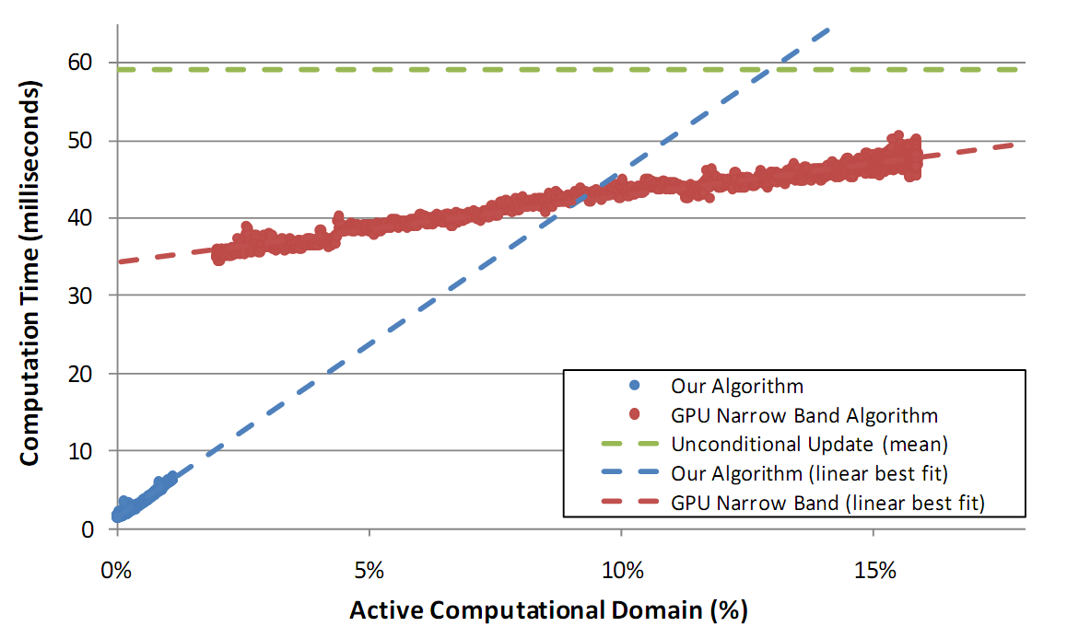
Speed vs. Computational Domain Size

Slide 60
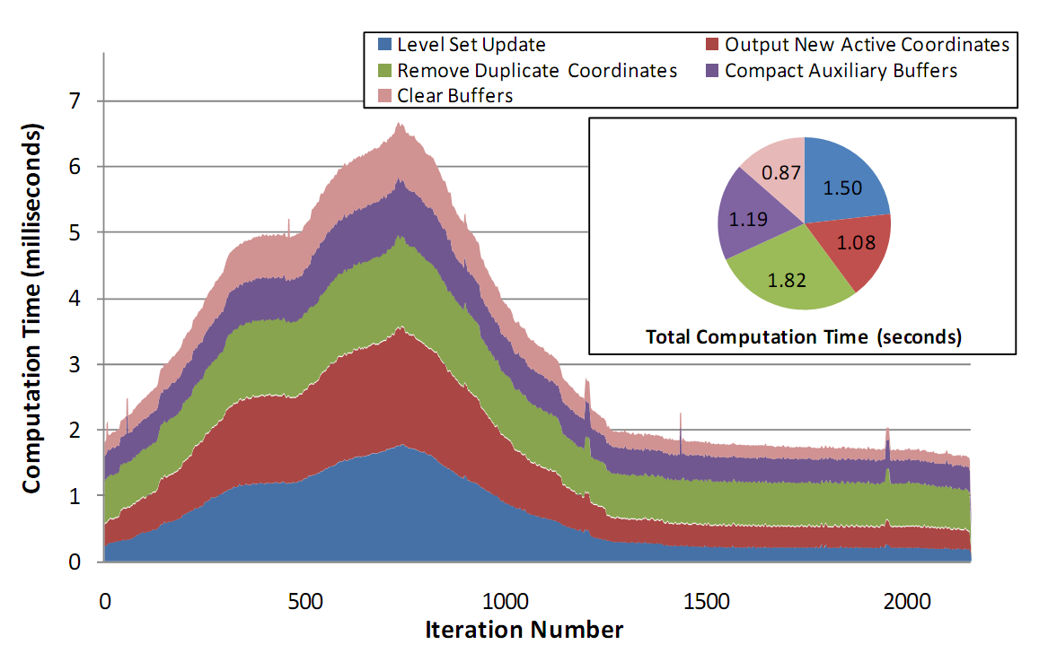
Speed per Subroutine

Slide 61

Results

Slide 62
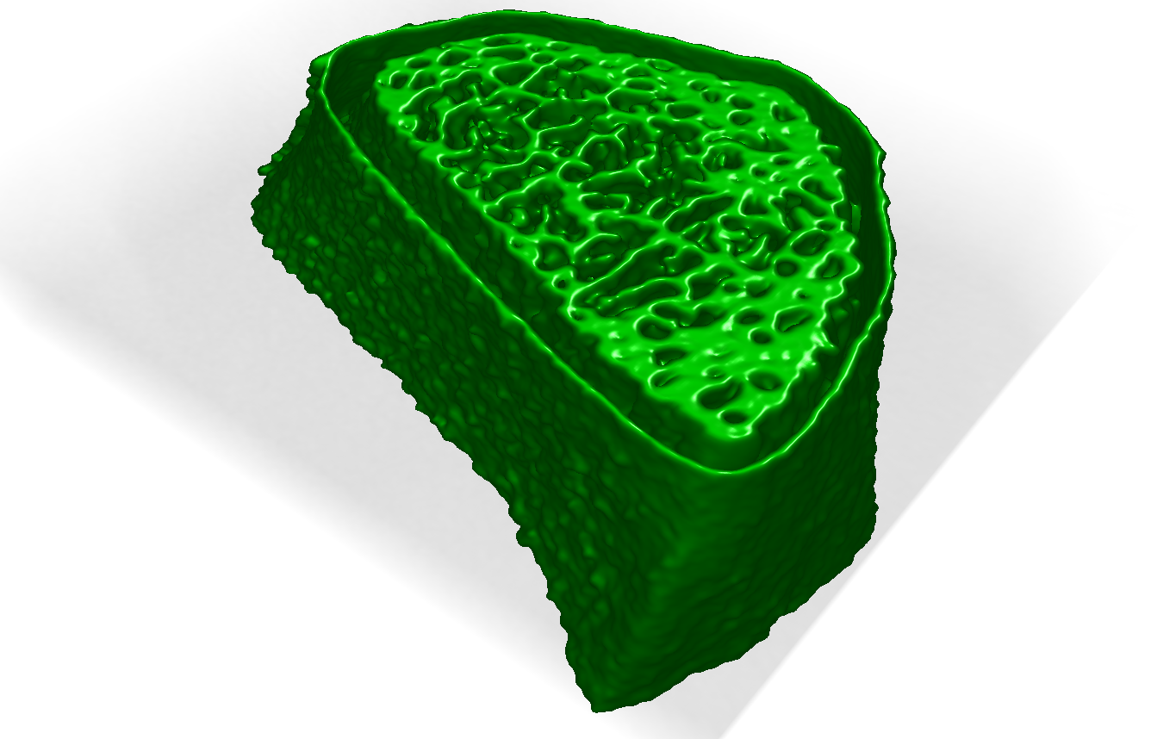
Results

Slide 63
Limitations
Requires a large amount of GPU memory
About 500 MB for a 256x256x256 data set
Scaling to high order neighborhoods increases memory requirements
Need extra auxiliary buffers
Increases redundant work per thread

Slide 64
Future Work
Reduce the memory requirements
Implement sparse representation of the level set field and other buffers (i.e. hierarchical run-length-encoded level sets) on the GPU
Applicable to other level set problems in computer graphics?
Fluid simulation, surface reconstruction, image restoration, etc
Are there other applications for the duplicate removal algorithm?

Slide 65
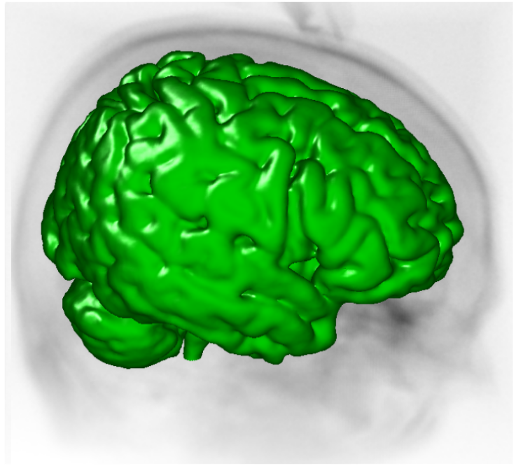
?
Questions?

